Slide 1


Slide 2
AI integration for ATM and Safety Management Systems and Intelligence
Dr. Lea Sophie Vink
Human Performance Lead, Austro Control – Vienna
Chairwoman CANSO HPM WG
Adjunct Professor Cognitive Neuropsychology
EATEO Conference – Rome, November 10th
Lea-sophie.vink@austrocontrol.at / LinkedIn: leasophievink

Slide 3
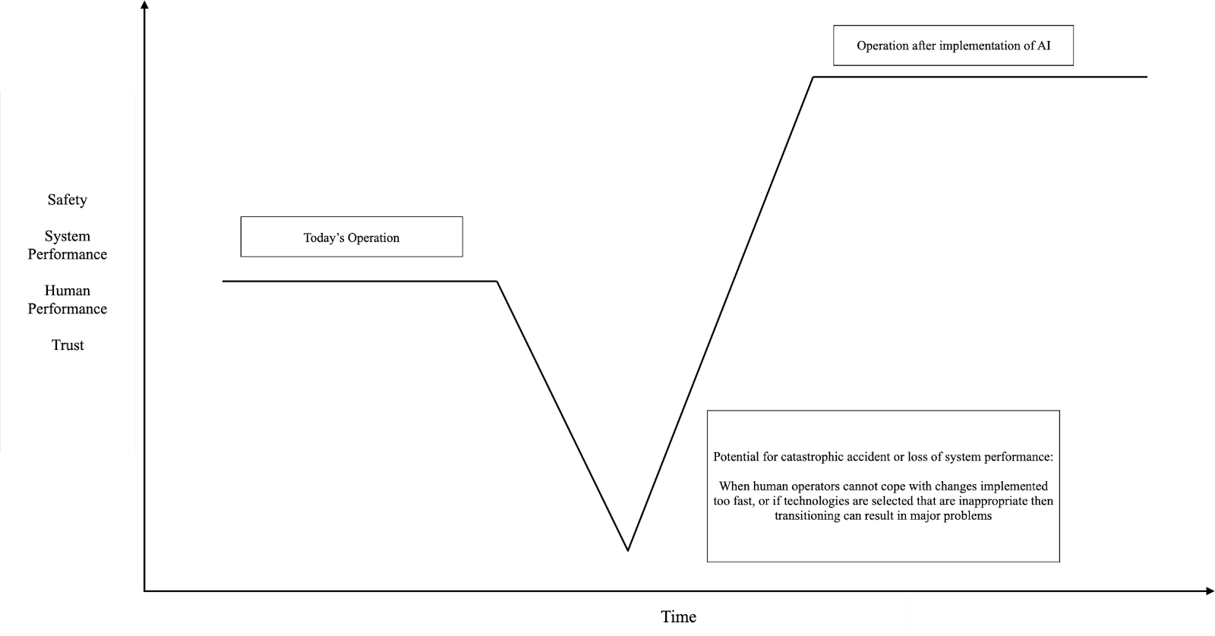
Change Management and AI

Slide 4

The Blackhole digital image was produced by 8 telescopes capturing data over one week. It was compiled using three different algorithms with less than 1% of the available data. It is an excellent metaphor for three reasons:
The brain is like a blackhole. We cannot see it or capture it, but we can capture and measure the light around it
The apporach to rendering a ‚picture‘ using a small ammount of data is applicable in human performance
The type of data is not the actaul object itself, but rather the behaviour of the surrounding data which ‚lights up‘ the actual object..
Human performacne can be thought of the same way…

Slide 5
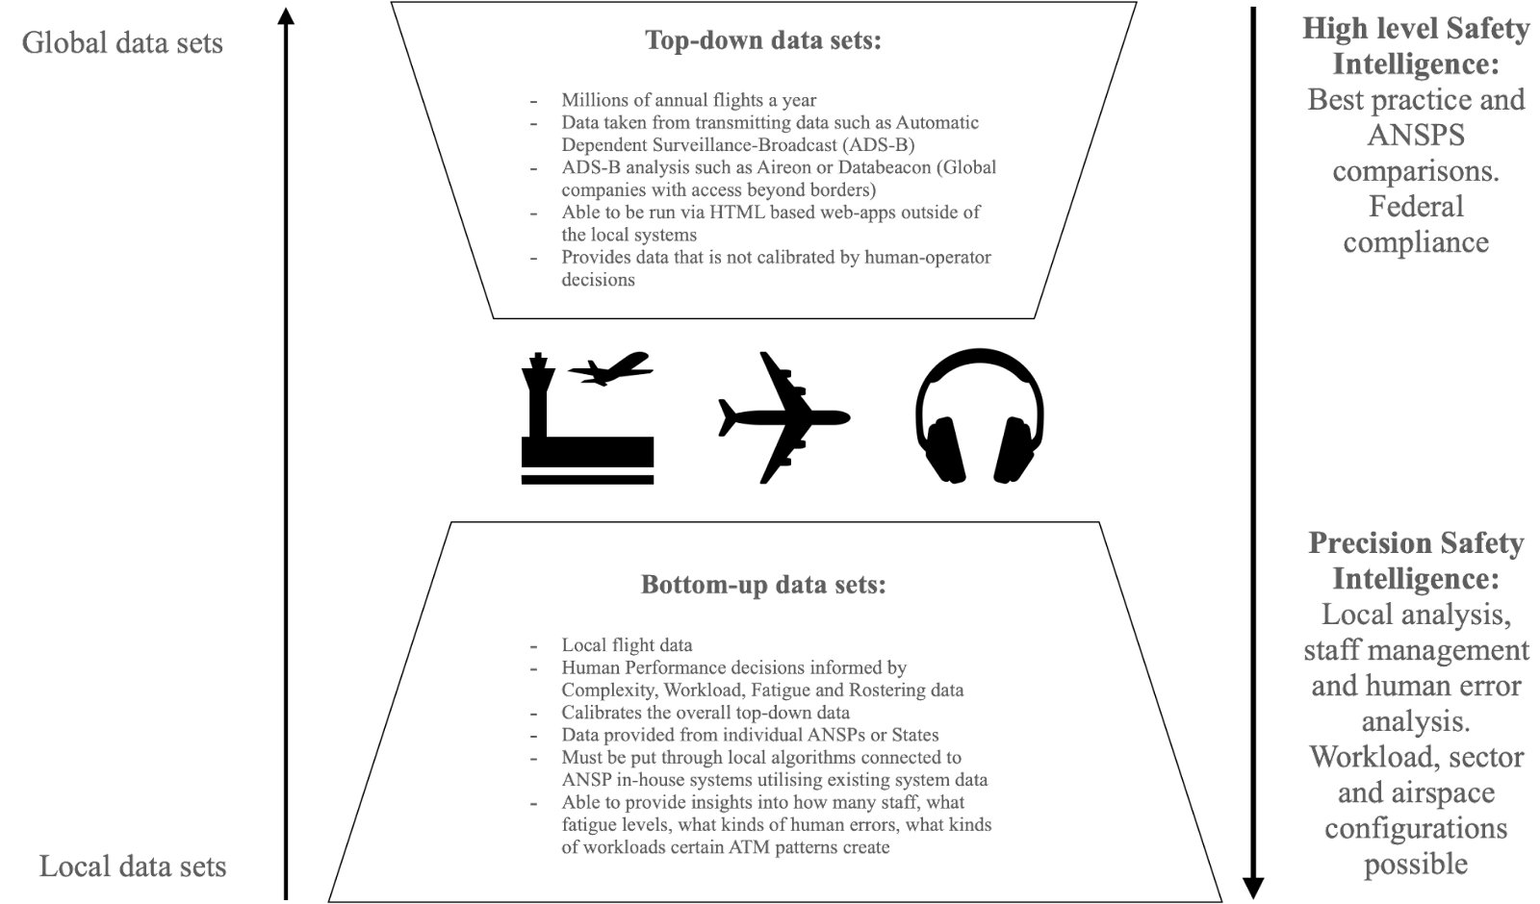
Big data and Safety Intelligence
Ziakkas, D. & Vink, L.S. (2023) The Handbook of Implementing AI in Aviation. Purdue University Press

Slide 6
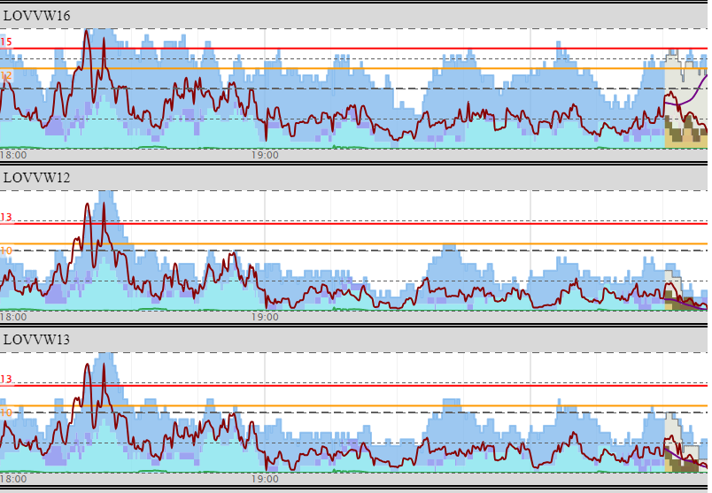
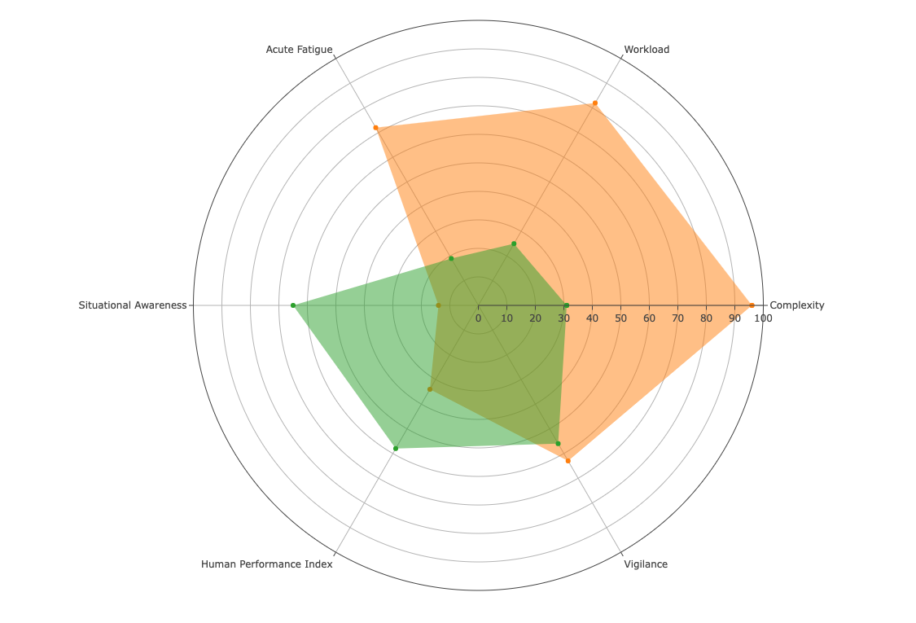
HP Picture predicting
Overload predicted accurately at 1820 UTC
Sector Overload Analysis – 23.09.2023 1820 UTC
ACC supervisors have access to this view.
The can see peaks and troughs in Total Complexity as well as to look into what is driving it.
It predicts using machine learning with relative accuracy.
Using the Human Performance Spider Diagrams, we can recreate analysis of occurences and see them before they happen.
Green = Av Sector Per 1800-1900 UTC Sep 2023
Orange = Snapshot of HP at 1820 UTC 23.09.2023

Slide 7
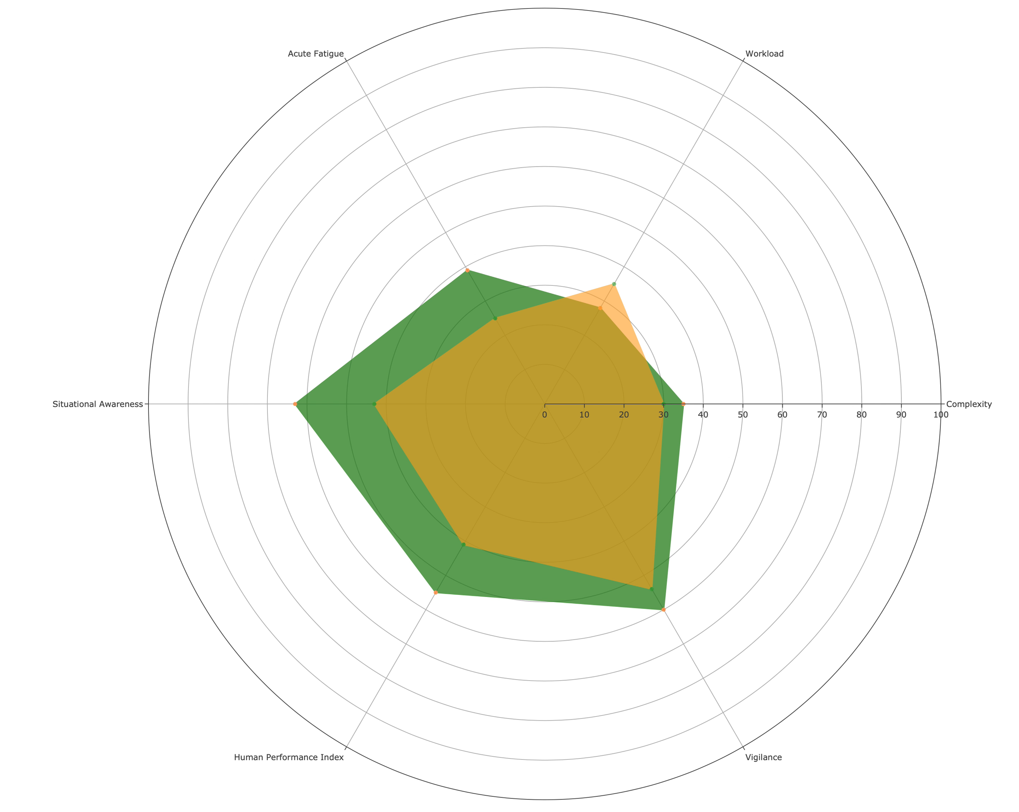
This is what the HMI shows live…

Slide 8
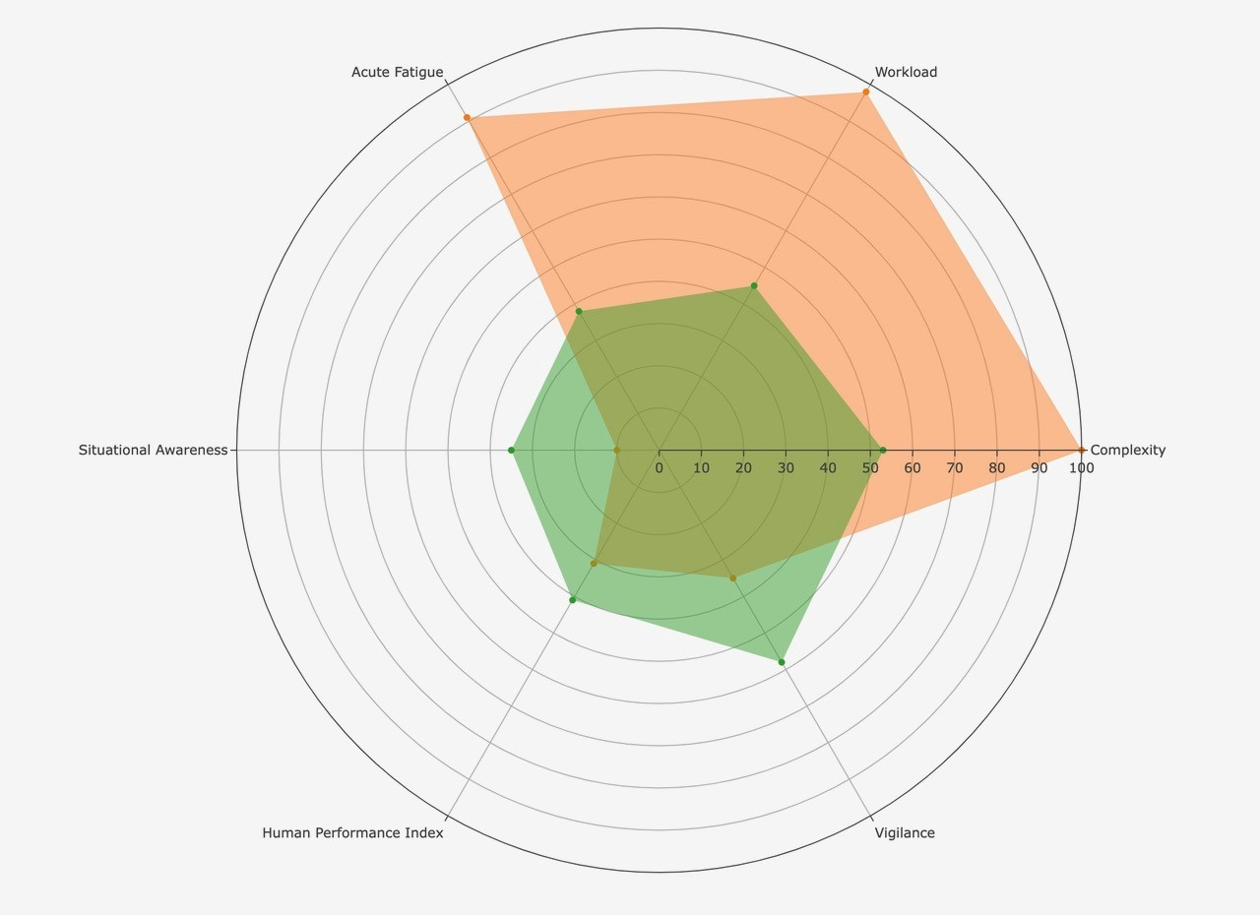
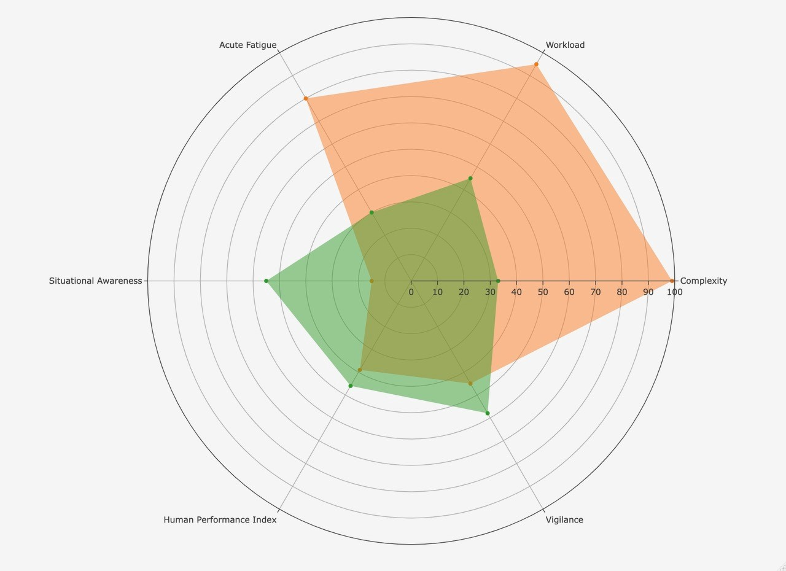
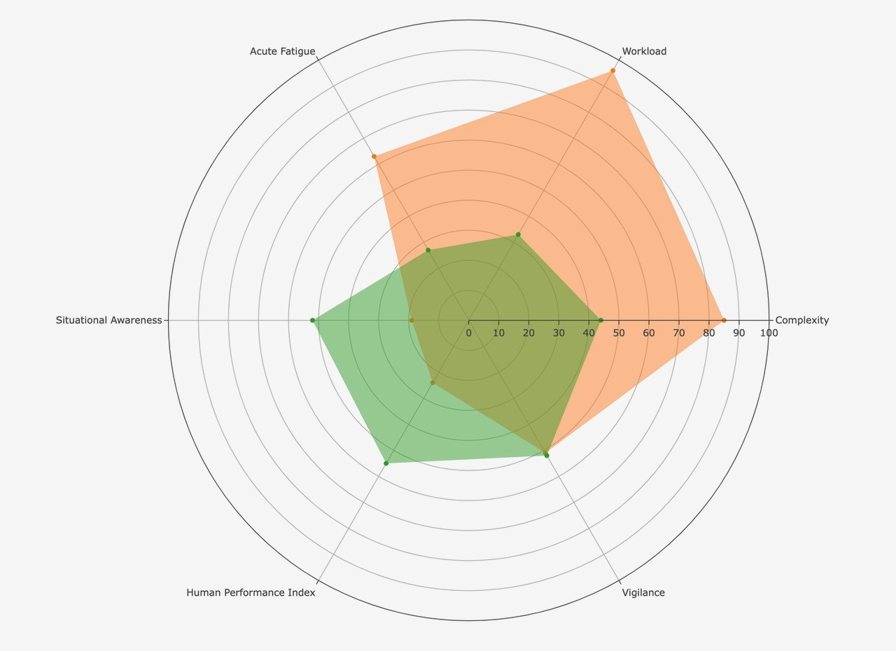
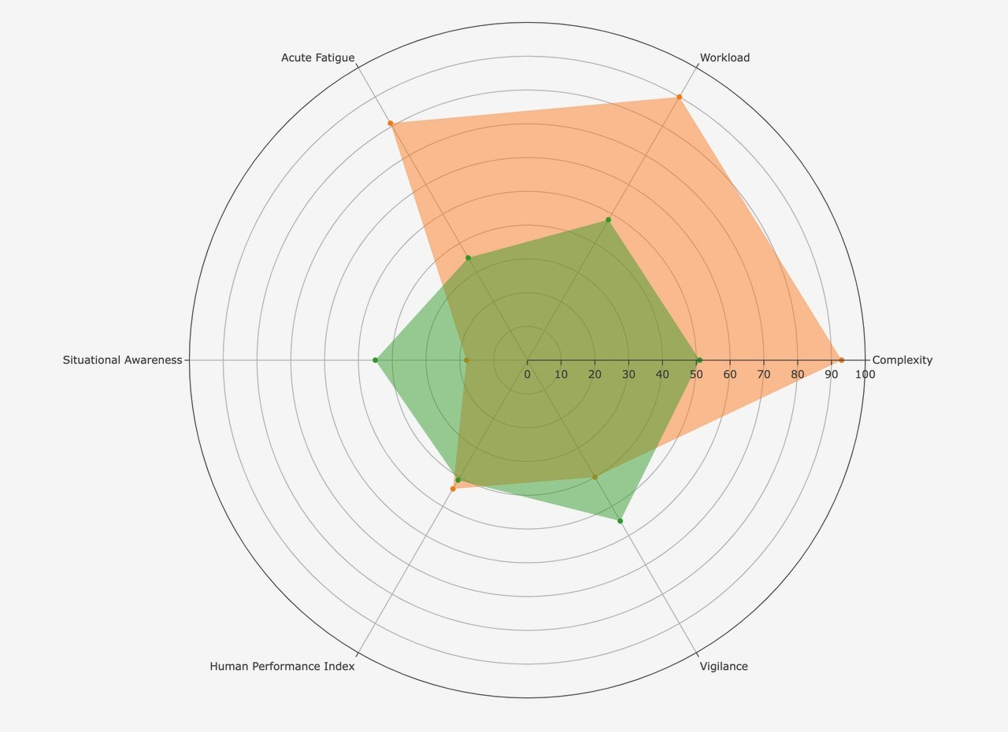
What do the patterns tell us?

Slide 10
How does Human Performance Work?

Slide 11
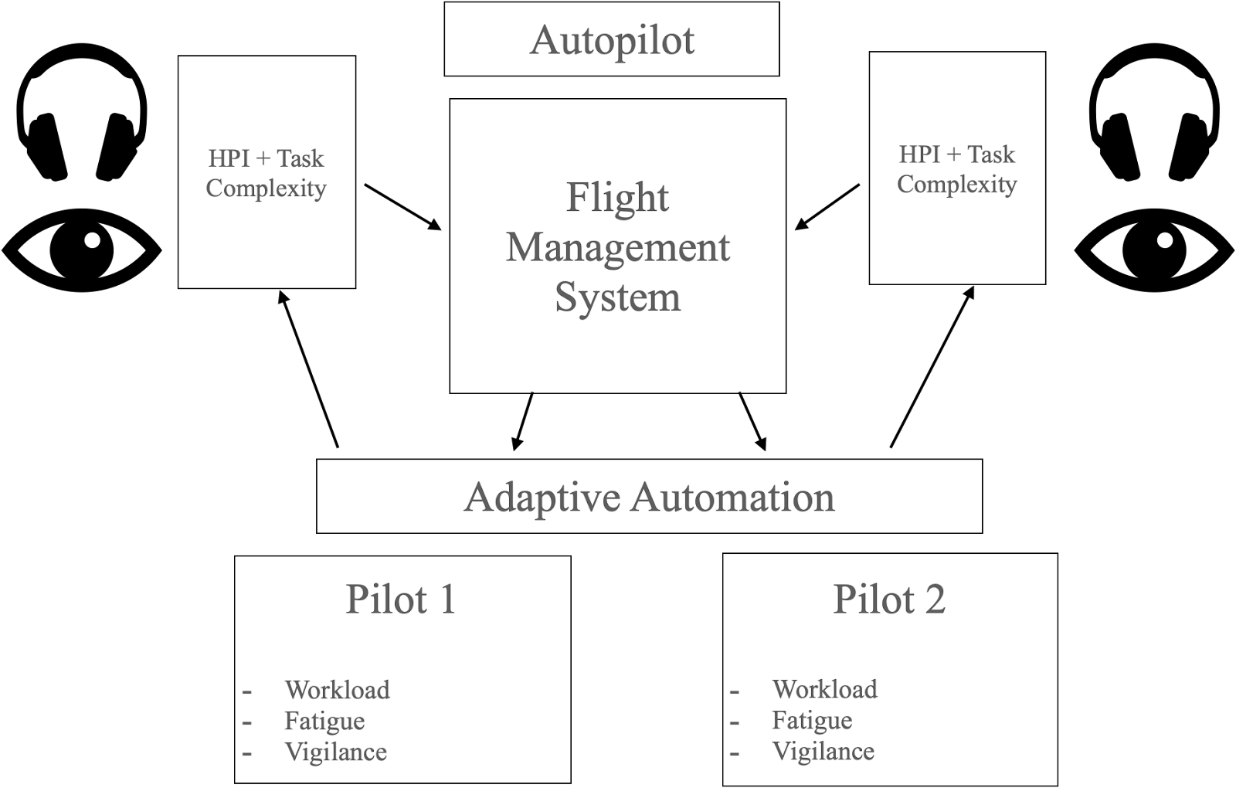
ATC informing Cockpits

